Slide 1
Art of Transfer Learning
G. Poorna Prudhvi, ML Engineer @ mroads
facebook: Poorna Prudhvi
twitter : @poornaprudhvi

Slide 2
First things first let’s look at different forms of learning (Explain me like I’m five year old)
Supervised Learning : Labels are specified
Unsupervised Learning : without labels or classes being specified
Reinforcement Learning : goal-directed learning from interaction
Semi Supervised Learning : it is a class of supervised learning tasks and techniques that also make use of unlabeled data for training – typically a small amount of labeled data with a large amount of unlabeled data

Slide 3
Artificial Neural Networks
An Artificial Neural Network (ANN) is an information processing paradigm that is inspired by the way biological nervous systems, such as the brain, process information. The key element of this paradigm is the novel structure of the information processing system. It is composed of a large number of highly interconnected processing elements (neurons) working in unison to solve specific problems. ANNs, like people, learn by example. An ANN is configured for a specific application, such as pattern recognition or data classification, through a learning process. Learning in biological systems involves adjustments to the synaptic connections that exist between the neurones. This is true of ANNs as well.

Slide 4
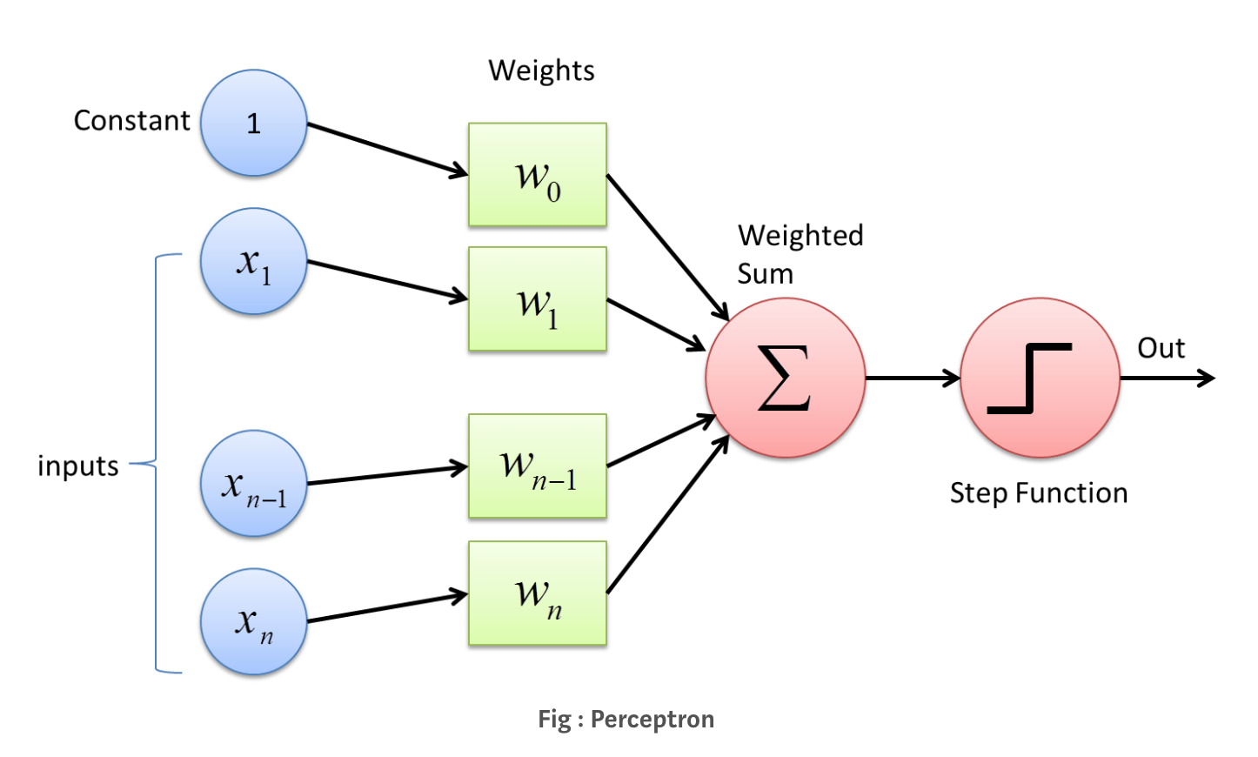
Perceptron
Perceptron is a single layer neural network
Perceptron is a linear classifier (binary)
Neural Networks works the same way as perceptron works
The perceptron consists of 4 parts . 1. Input values or One input layer 2. Weights and Bias 3. Net sum 4. Activation Function

Slide 5
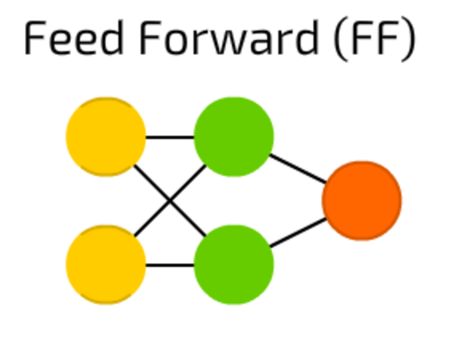
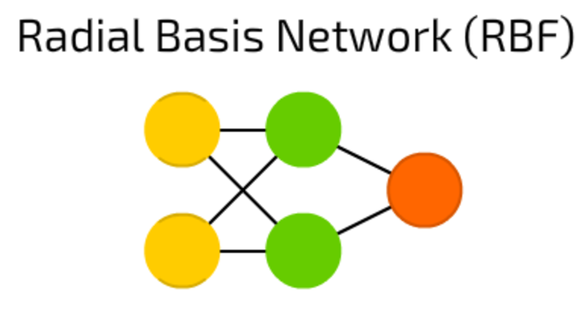
Different types of NN’s
Feed Forward Neural Network:
The simplest of all neural networks, the feedforward neural network, moves information in one direction only. Data moves from the input nodes to the output nodes, passing through hidden nodes (if any). The feedforward neural network has no cycles or loops in its network.
Radial Basis Function:
The RBF neural network is the first choice when interpolating in a multidimensional space. The RBF neural network is a highly intuitive neural network. Each neuron in the RBF neural network stores an example from the training set as a “prototype”. Linearity involved in the functioning of this neural network offers RBF the advantage of not suffering from local minima.

Slide 6
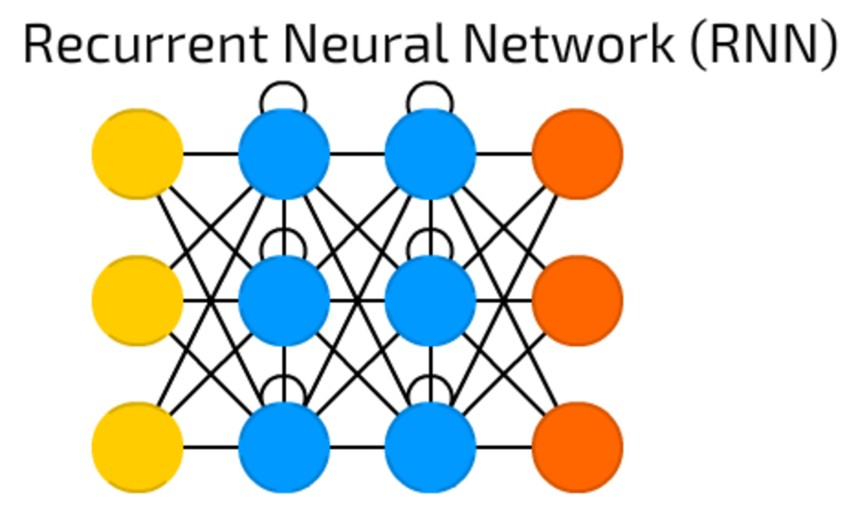
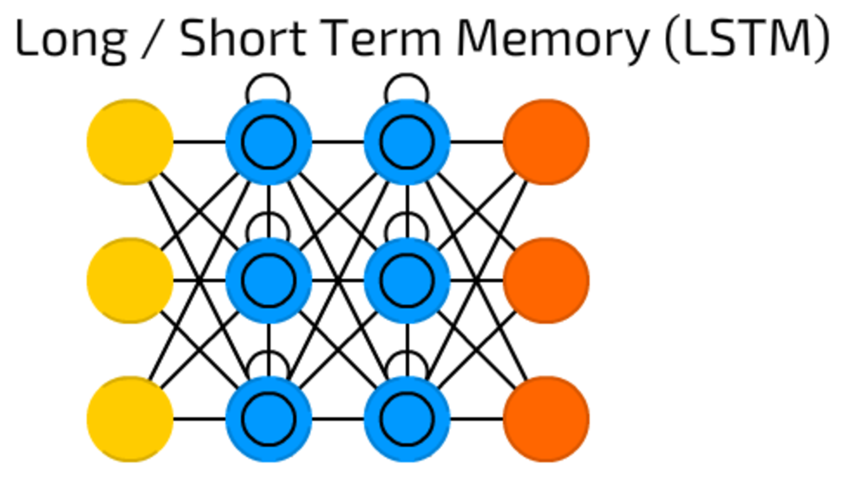
Contd..
Recurrent Neural Networks:
The recurrent neural network, unlike the feedforward neural network, is a neural network that allows for a bi-directional flow of data. The network between the connected units forms a directed cycle. Such a network allows for dynamic temporal behavior to be exhibited. The recurrent neural network is capable of using its internal memory to process arbitrary sequence of inputs. This neural network is a popular choice for tasks such as handwriting and speech recognition.
Long Short Term Memory :
RNN’s take care of ten previous words but these take care of a frame which happened long back. Useful in time lags and these are most widely used in speech recognition. Contains backfed input cells.

Slide 7
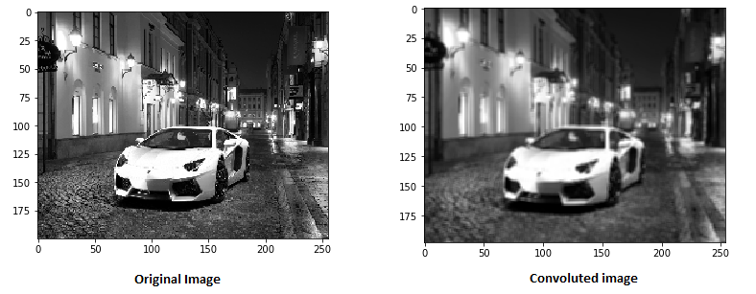
Convolutional Neural Networks

Slide 8
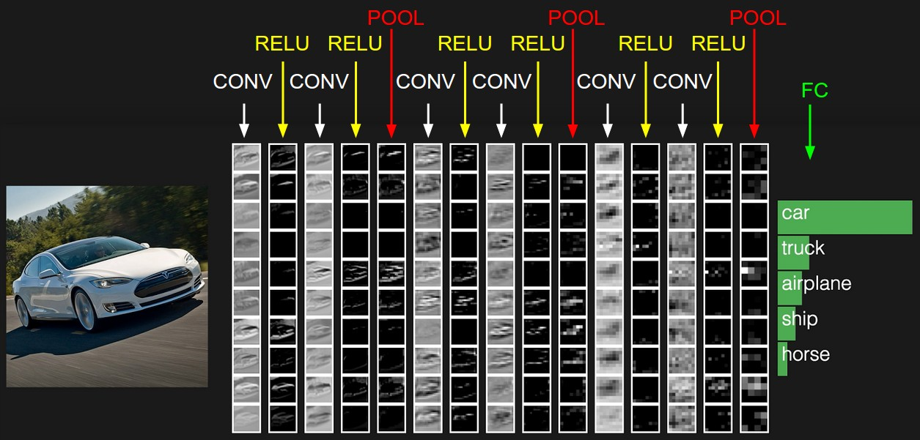
Contd..

Slide 9
Now we have known enough to start with transfer learning
What do you think is transfer learning?
(Let it be as silly as possible)

Slide 10
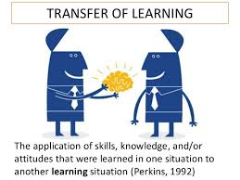
Transfer Learning
Let’s draw the intuition from a student-teacher analogy
Here a neural network is trained on a data. This network gains knowledge from this data, which is compiled as “weights” of the network. These weights can be extracted and then transferred to any other neural network. Instead of training the other neural network from scratch, we “transfer” the learned features.

Slide 11
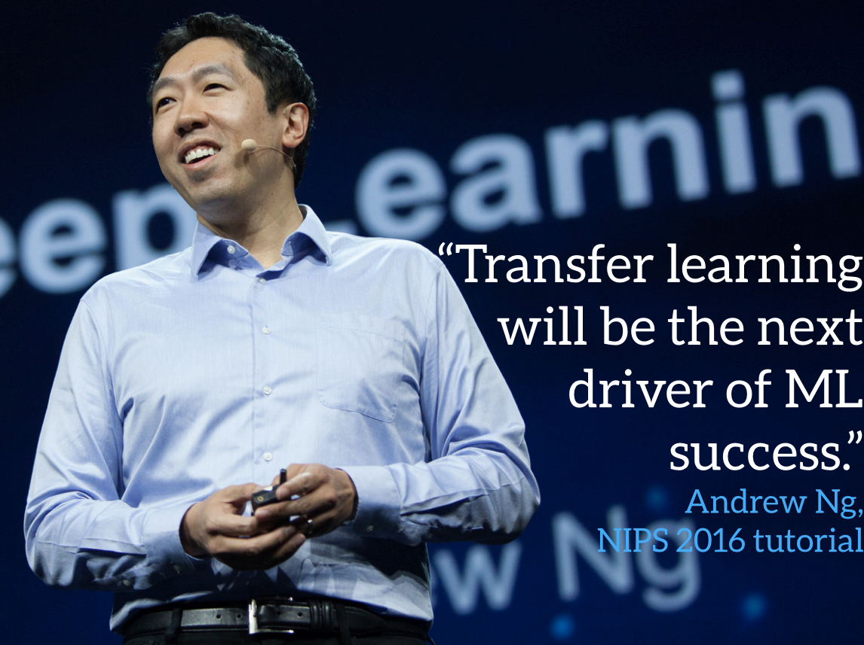
Why Transfer Learning ?
The amount of datasets required to model a solution to a particular domain and the amount of training time and the computing capacity required will be reduced without compromising the accuracy of the trained models.

Slide 12
Three types of transfer learning
ConvNet as fixed feature extractor:
Take a pre trained CNN, remove the last fully-connected layer (this layer’s outputs are the 1000 class scores for a different task like ImageNet), then treat the rest of the ConvNet as a fixed feature extractor for the new dataset.
Fine-tuning the ConvNet:
The second strategy is to not only replace and retrain the classifier on top of the ConvNet on the new dataset, but to also fine-tune the weights of the pretrained network by continuing the backpropagation.
Pretrained models:
Using pretrained models like in Model Zoo

Slide 13
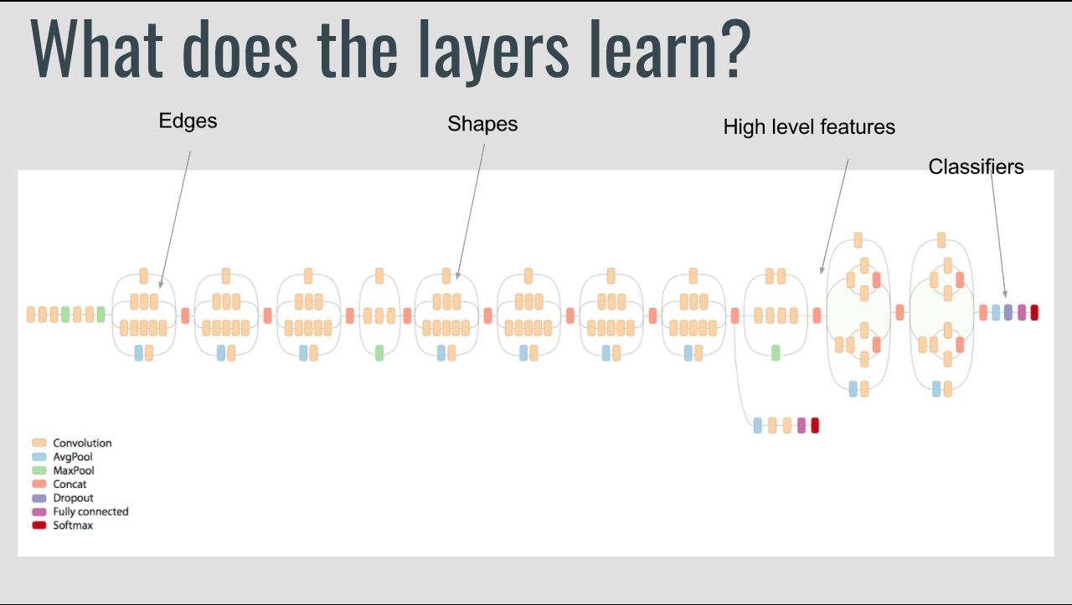

Slide 14
Applications of Transfer Learning
Learning from simulations (Training using simulated data )
Adapting to new domains ( Models trained on news data adaption to tweet data)
Transferring knowledge across languages (Translation model trained on one language across different languages)

Slide 15
Let’s Walk through the code of a basic Image classifying CNN and explore the problems here at malai repo/transfer-learning

Slide 16
Let’s start our code lab exercise
https://codelabs.developers.google.com/codelabs/tensorflow-for-poets

Slide 17
References
http://ruder.io/transfer-learning/index.html#applicationsoftransferlearning
http://cs231n.github.io/convolutional-networks/
https://www.analyticsvidhya.com/blog/2017/06/transfer-learning-the-art-of-fine-tuning-a-pre-trained-model/
Google codelabs

Slide 18
Thank you :)

